Slide 1

STATS 250 Lab 3
Jiangyue Mao

Slide 2
Course Reminders
Assignment | Due Date
Lab 3 | Friday, February 17th by 11:59pm
Homework 4 | Friday, February 17th by 11:59pm
MWrite #1 Revision | Friday, February 17th by 11:59pm
Exam 1 | Wednesday, February 22nd
More information about Exam 1 on the next slide

Slide 3
Exam 1 Information
Exam 1 will be held on Wednesday, February 22nd
The exam window will be open from 8:00am to 11:59pm
You have 150 minutes (2.5 hours) to complete the exam once you begin
Written as a 90-minute exam with extra time for file uploads
You may resubmit as many times as needed in your 150-minute window
Please start by 9:29pm if you wish to have the full 150 minutes
(I.e., if you start at 11:00pm, you will only have 59 minutes to complete it)
Administered in Gradescope
Mix of multiple choice, numeric input, free response, and file upload

Slide 4
Exam 1 Resources
There are several resources to help you study for Exam 1
Practice Exam (on Gradescope)
Similar format and length as the real exam
Solutions posted to Canvas
Practice Concepts for Exam 1
Additional review questions to help you prepare
Not the length of an actual exam
Problem Roulette
Bank of old exam questions (that have been converted to multiple choice)
Recommended Homework
Required Homework
Print out blank homework assignments and redo problems

Slide 5
Lab 3
Learning Objectives
Explore how statistics change from sample to sample
Understand sampling distributions
Simulate the sampling distribution of Xbar for various sample sizes
Understand and apply the Central Limit Theorem (CLT)

Slide 6
Lab 3
Head to https://rstudio.cloud/
If you are not signed in…
Click on “Log In”
Click “Log In with Google”
Log In with your UM credentials
Click the “Start” button next to the “lab03” assignment

Slide 7
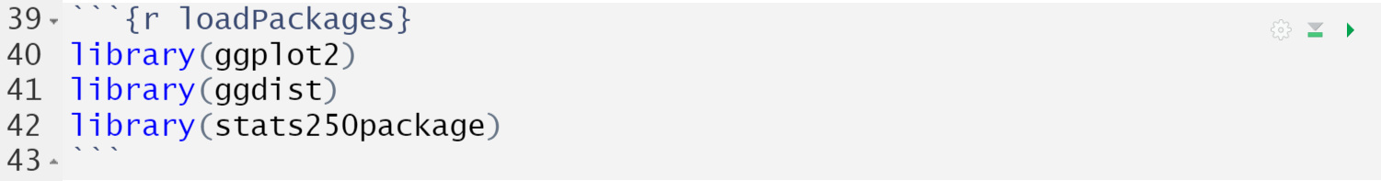
stats250package
A powerful benefit of R is that users can create their own functions, store them in a package, and make it available for others to use.
We have created our own package which contains useful functions that we'll be utilizing over the next few labs. We will also be utilizing two other external packages. Be sure to run the code chunk to load in our package.

Slide 8
employee
The employee data set contains information for all 473 employees at a certain company. The variables included in the data set are:
salary: annual salary (in dollars)
age: age of the employee (in years)
edu: years of education (in years)
startsal: starting salary (in dollars)
jobtime: time with the company (in months)
prevexp: previous work experience (in months)
minority: yes or no
female: yes or no
manager: yes or no

Slide 9
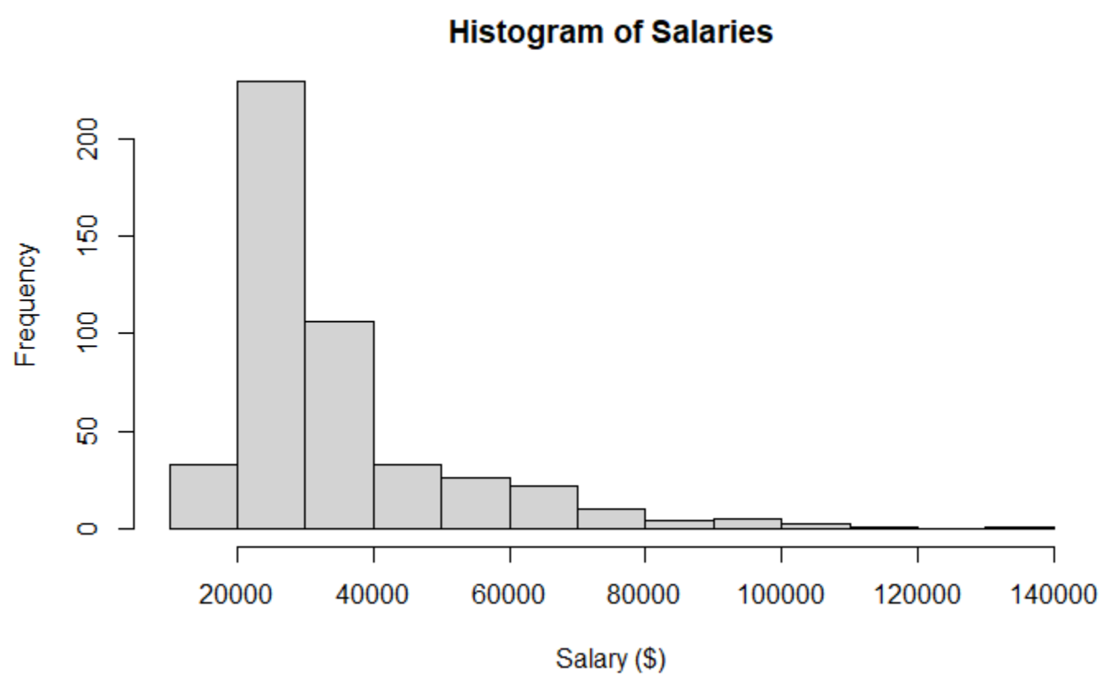
Population Distribution
A distribution that includes all observations for a group of interest
The employee data set includes all 473 employees of a company
From the histogram, the distribution is heavily skewed to the right

Slide 10
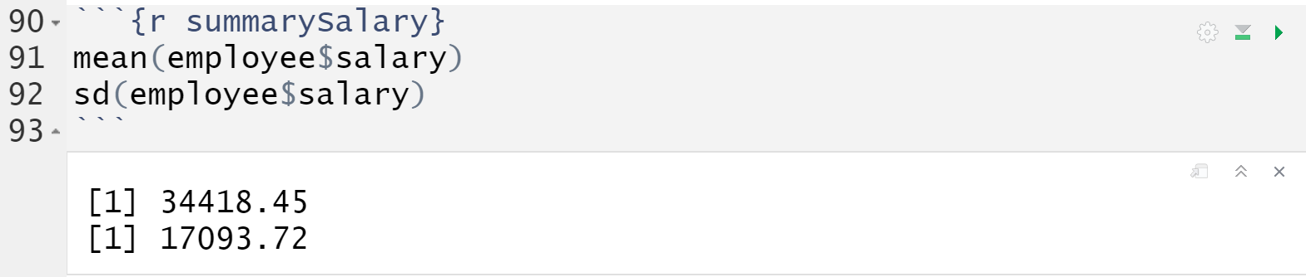
Population Distribution
We could also calculate specific numerical summaries.
Are these parameters or statistics?

Slide 11
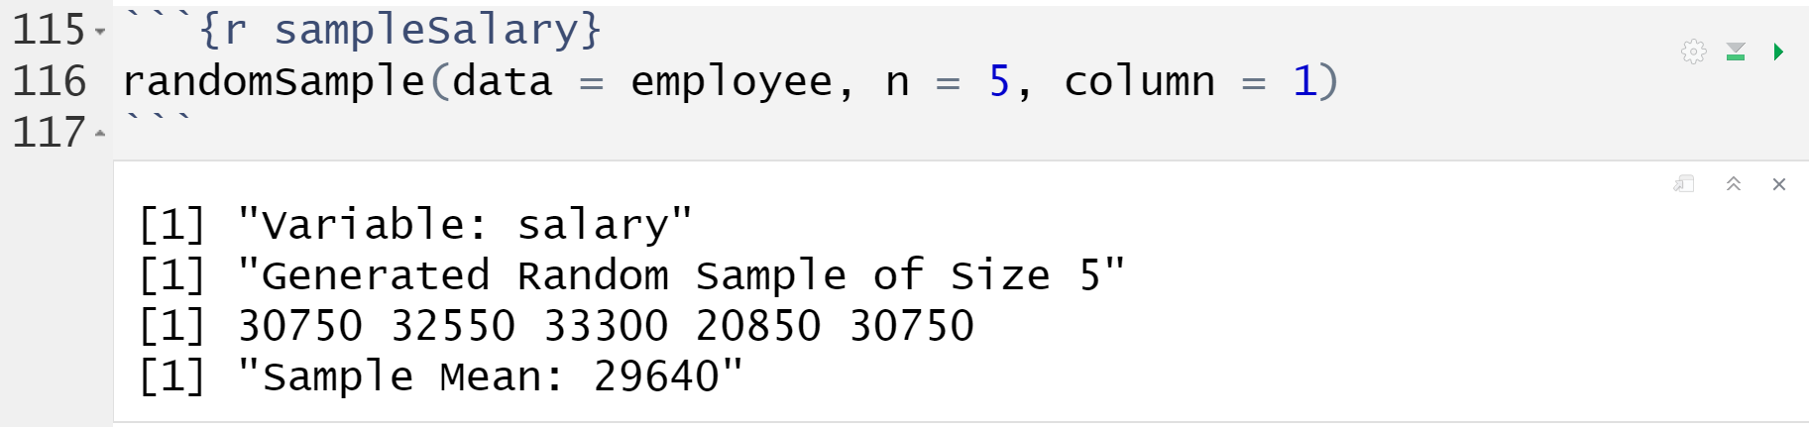
randomSample()
Takes a random sample and calculates the sample mean
Arguments:
data: the data set of interest (employee)
n: the size of the random sample (n = 5)
column: the column number of the variable of interest (column = 1)

Slide 12
Think-Pair-Share
Think: individually reflect on the question
Pair: discuss with a small group
Share: discuss with the entire lab section
First, run the code chunk once. Is your sample mean the same as the population mean ($34,418)? Did you expect it to be? Why or why not?
Then, run the code chunk multiple times, paying close attention to the sample mean value and how much it varies from sample to sample. Do you think it would vary by more, less, or the same if we increased the size of our random sample to 25? Why?

Slide 13
Demo #1
Use the randomSample() function to draw a random sample of size 25 for the salary variable. Run the code chunk multiple times – again paying attention to the value of the sample mean.
After running the code chunk multiple times, does the sample mean seem to vary by more, less, or the same amount (compared to when the sample size was 5)?

Slide 14
Demo #1
Use the randomSample() function to draw a random sample of size 25 for the salary variable. Run the code chunk multiple times – again paying attention to the value of the sample mean.

Slide 15
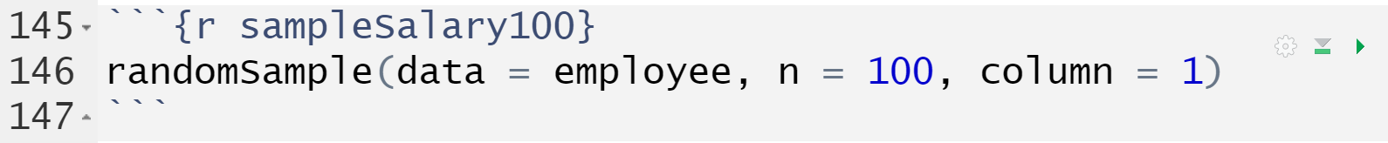
randomSample()
What happens to the sample mean when we increase the size of our sample to 100?
If you run the above code chunk multiple times, you should notice that the sample mean does not vary by much from sample-to-sample!

Slide 16


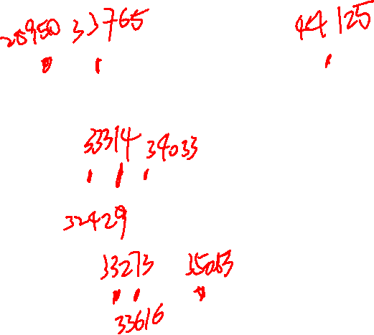

Comparison
$$n=5$$
20,000 25,000 30,000 35,000 40,000 45,000 50,000
$$n=25$$
20,000 25,000 30,000 35,000 40,000 45,000 50,000
$$n=100$$
20,000 25,000 30,000 35,000 40,000 45,000 50,000

Slide 17
Sampling Distribution
A sampling distribution is the distribution of all possible values of a statistic (such as the sample mean) for repeated samples of the same size (n)
This can be very tricky to wrap our heads around!
We generally only take one sample of data from the population
The sampling distribution is theoretical – one that would be created if we took many, many random samples from the population

Slide 18















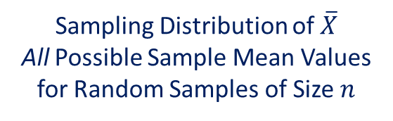






Sampling Distribution of $\overline{X}$
The most used sampling distribution is for the sample mean ($\overline{X}$)
How would we expect the possible values of $\overline{X}$ to vary for many random samples of size $n$?
Where would this sampling distribution be centered?
What would be the spread of this sampling distribution?
What shape would this sampling distribution have?
$$\overline{x}$$
$$\overline{x}$$
Sampling Distribution of $\overline{X}$
All Possible Sample Mean Values
for Random Samples of Size $n$
$$\overline{x}$$
$$\overline{x}$$
$$\overline{x}$$
$$\overline{x}$$
$$\overline{x}$$
$$\overline{x}$$
$$\overline{x}$$
$$\overline{x}$$
$$\overline{x}$$
$$\overline{x}$$
$$\overline{x}$$
$$\overline{x}$$
$$\overline{x}$$
$$\overline{x}$$
$$\overline{x}$$
$$\overline{x}$$
$$\overline{x}$$

Slide 19
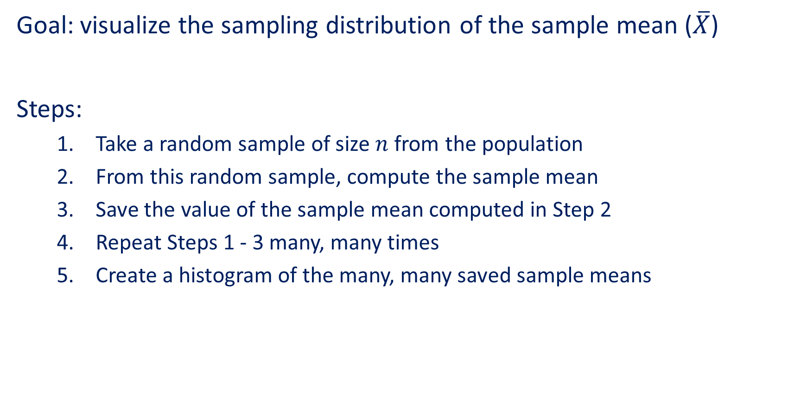
Simulation
Goal: visualize the sampling distribution of the sample mean ($\overline{X}$)
Steps:
Take a random sample of size $n$ from the population
From this random sample, compute the sample mean
Save the value of the sample mean computed in Step 2
Repeat Steps 1 - 3 many, many times
Create a histogram of the many, many saved sample means

Slide 20
samplingDistXbar() Function
This function…
Takes 1,000 random samples of size n from the specified variable
Calculates the sample mean of each random sample
Plots a histogram of the 1,000 sample means
Arguments:
data: the data set of interest (employee)
n: the size of the random sample (n = 5)
column: the column number of the variable of interest (column = 1)

Slide 21
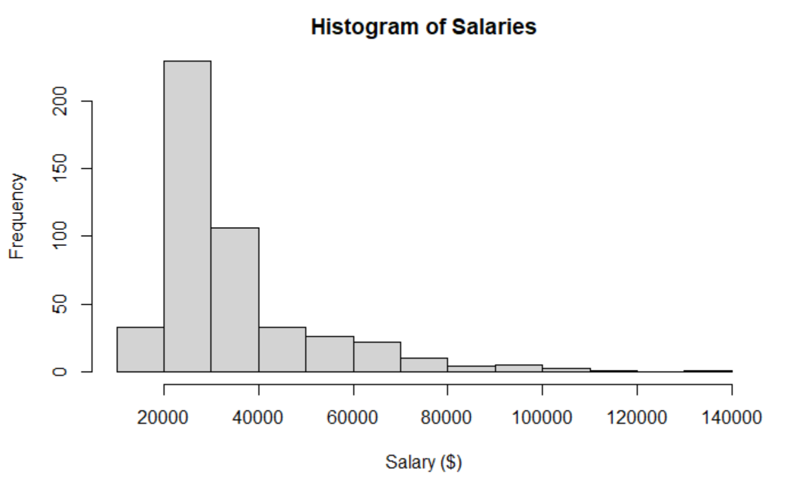


Population Distribution of $X$
The average salary is $34,418.45 ($μ$)
The overall range of salaries is roughly $10,000 to $140,000
The distribution of salaries is unimodal and heavily skewed to the right

Slide 22
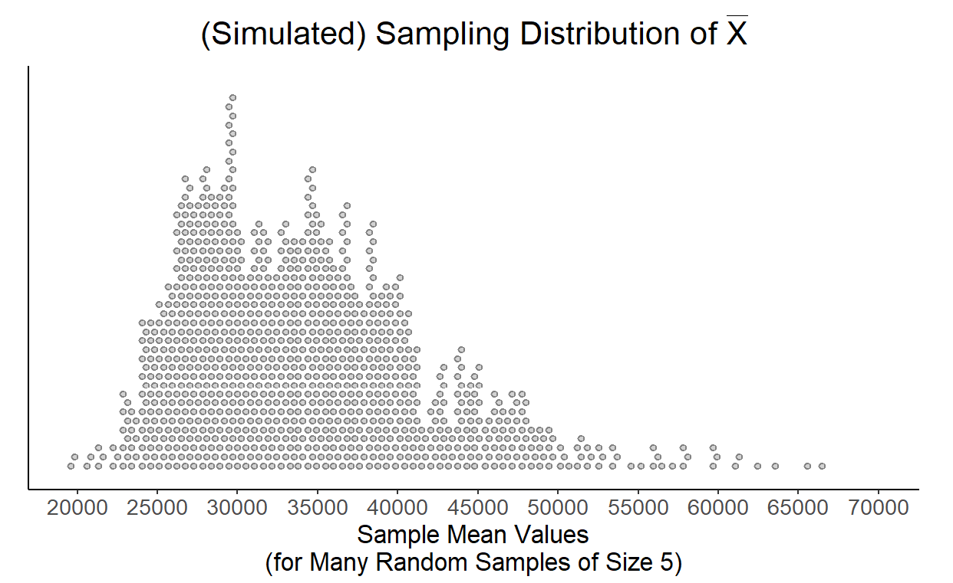

Sampling Distribution of $\overline{X}$ (n = 5)
The center is: the same (roughly 30,000 – 35,000)
The spread is: narrower (overall range has decreased)
The shape is: skewed right, but less severe than the population distribution

Slide 23
Demo #2
Using the samplingDist() function, create the sampling distribution of sample means for random samples of size 25 (n = 25) for the salary variable (column = 1) in the employee data set.
How would you describe the shape of this sampling distribution?

Slide 24
Demo #2
Using the samplingDist() function, create the sampling distribution of sample means for random samples of size 25 (n = 25) for the salary variable (column = 1) in the employee data set.

Slide 25
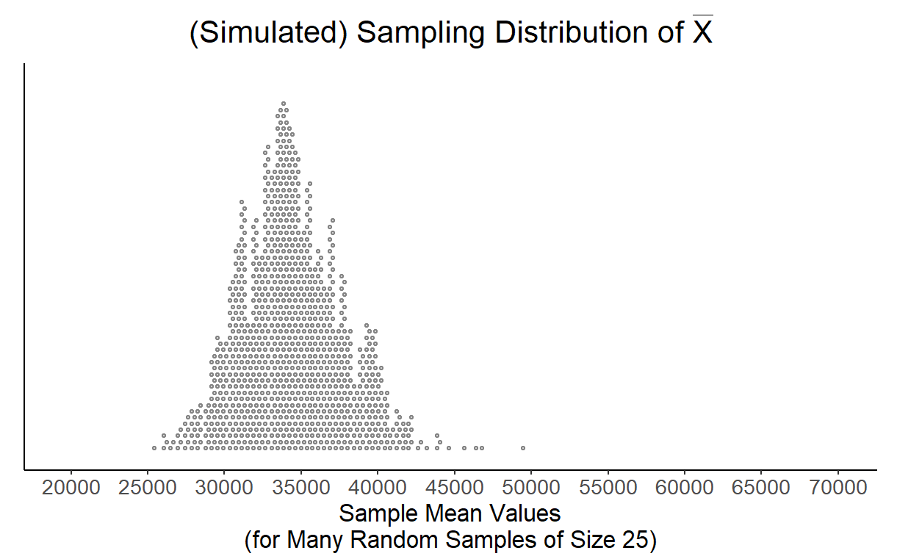
Sampling Distribution of $\overline{X}$ (n = 25)
The center is: the same (roughly 34,000)
The spread is: even narrower (overall range has decreased even more)
The shape is: approximately normal

Slide 26
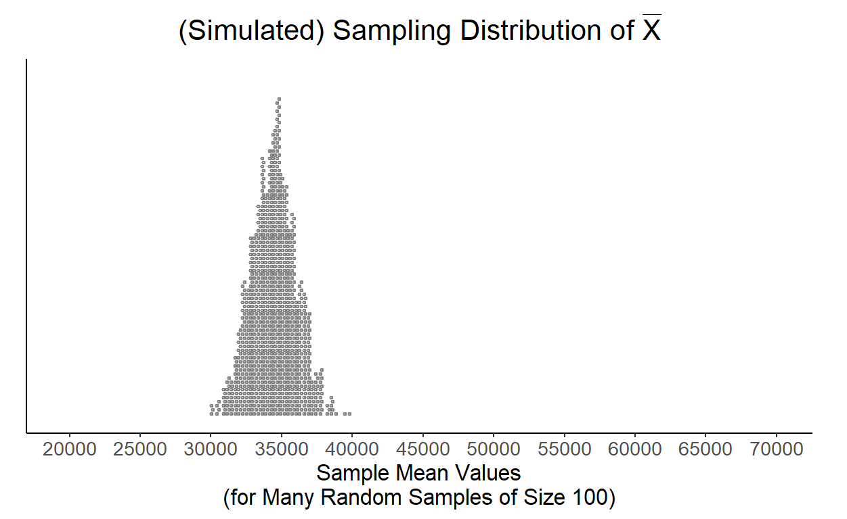

Sampling Distribution of $\overline{X}$ (n = 100)
The center is: the same (roughly 34,000)
The spread is: even narrower (overall range has decreased even more)
The shape is: (approximately) normal, even more bell-shaped than Demo #2

Slide 27
Think-Pair-Share
Think: individually reflect on the question
Pair: discuss with a small group
Share: discuss with the entire lab section
In which of the three scenarios (n = 5, n = 25, n = 100) would the sample mean be the best estimator of the true population mean? Why?
In which of the three scenarios (n = 5, n = 25, n = 100) would observing a sample mean salary of $40,000 be the most unusual? Why?

Slide 28
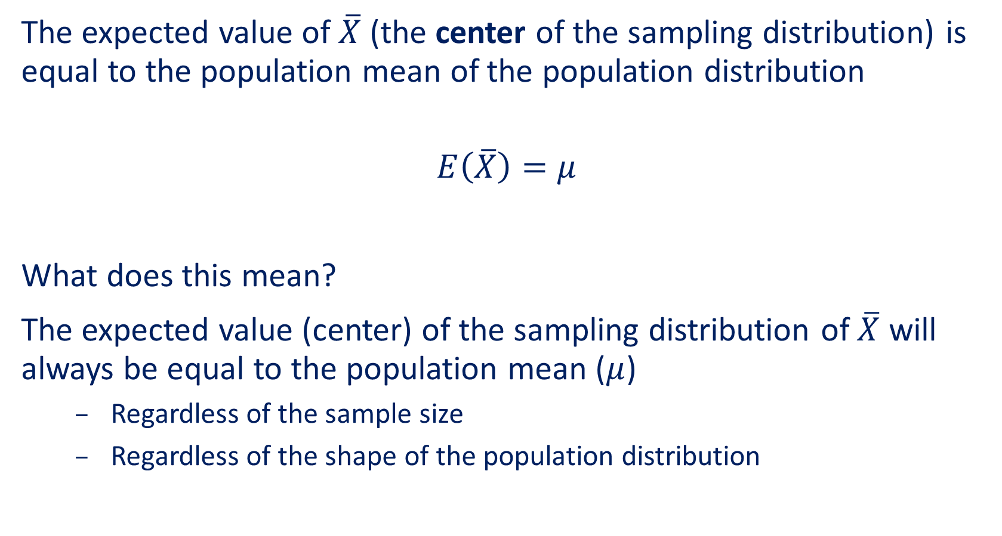

Sampling Distribution of $\overline{X}$
The expected value of $\overline{X}$ (the center of the sampling distribution) is equal to the population mean of the population distribution
$$E\left(\overline{X}\right)=μ$$
What does this mean?
The expected value (center) of the sampling distribution of $\overline{X}$ will always be equal to the population mean ($μ$)
Regardless of the sample size
Regardless of the shape of the population distribution

Slide 29
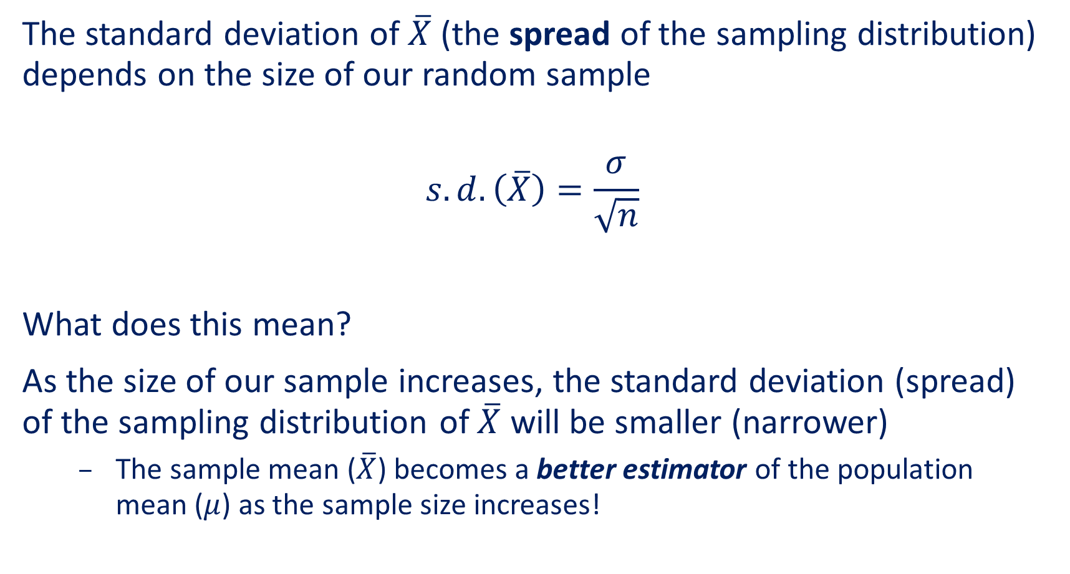
Sampling Distribution of $\overline{X}$
The standard deviation of $\overline{X}$ (the spread of the sampling distribution) depends on the size of our random sample
$$s.d.\left(\overline{X}\right)=\frac{σ}{\sqrt{n}}$$
What does this mean?
As the size of our sample increases, the standard deviation (spread) of the sampling distribution of $\overline{X}$ will be smaller (narrower)
The sample mean ($\overline{X}$) becomes a better estimator of the population mean ($μ$) as the sample size increases!

Slide 30

Conclusions
For the sampling distribution of $\overline{X}$…
$$E\left(\overline{X}\right)=μ$$
$$s.d.\left(\overline{X}\right)=\frac{σ}{\sqrt{n}}$$

Slide 31
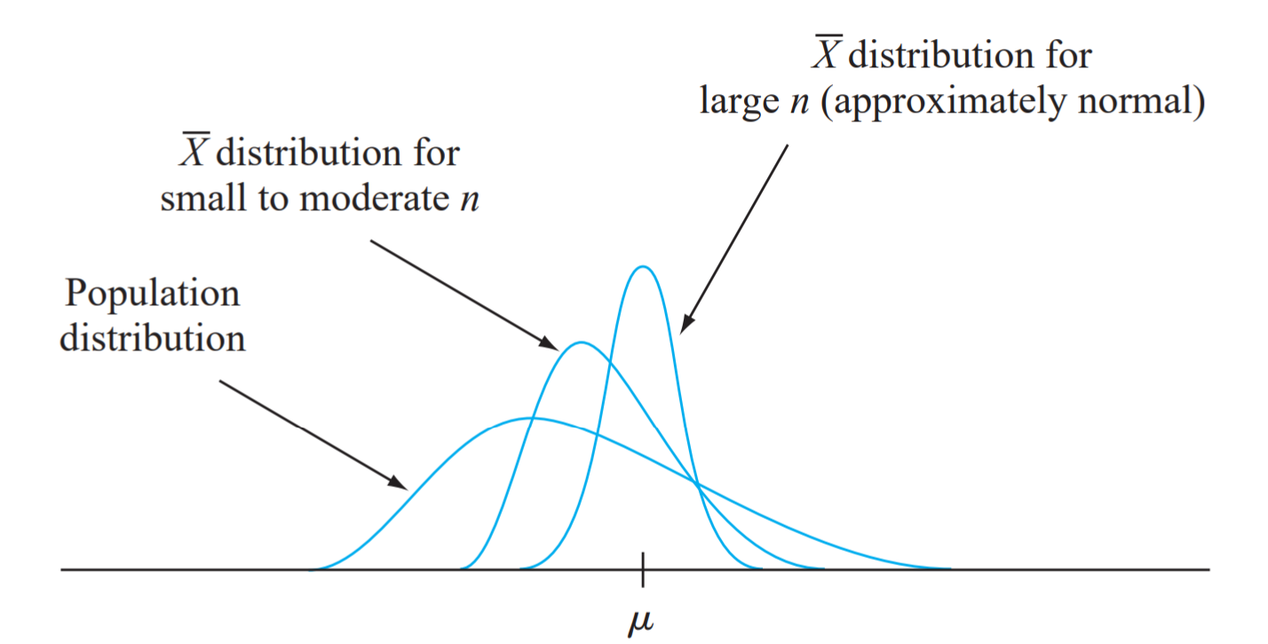

Sampling Distribution of $\overline{X}$
The shape of the sampling distribution of $\overline{X}$ depends on the shape of the population distribution
If the population distribution is not normally distributed, then the sampling distribution of $\overline{X}$ will be approximately normal when the sample size is sufficiently large

Slide 32
Central Limit Theorem
This cute video does a great job illustrating the Central Limit Theorem
https://www.youtube.com/watch?v=jvoxEYmQHNM
Another great applet can be found here:
http://onlinestatbook.com/stat_sim/sampling_dist/index.html

Slide 33
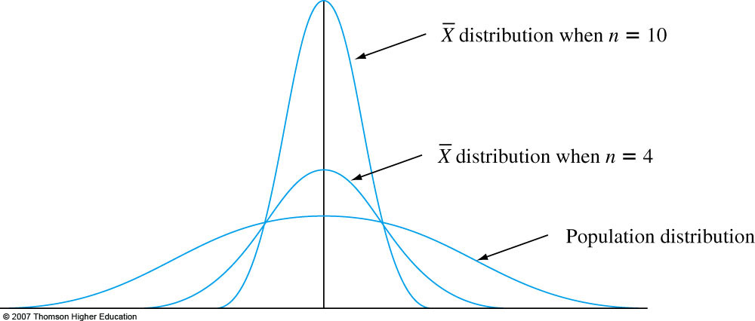

Sampling Distribution of $\overline{X}$
The shape of the sampling distribution of $\overline{X}$ depends on the shape of the population distribution
If the population distribution is normally distributed, then the sampling distribution of $\overline{X}$ will be normally distributed

